Slide 2
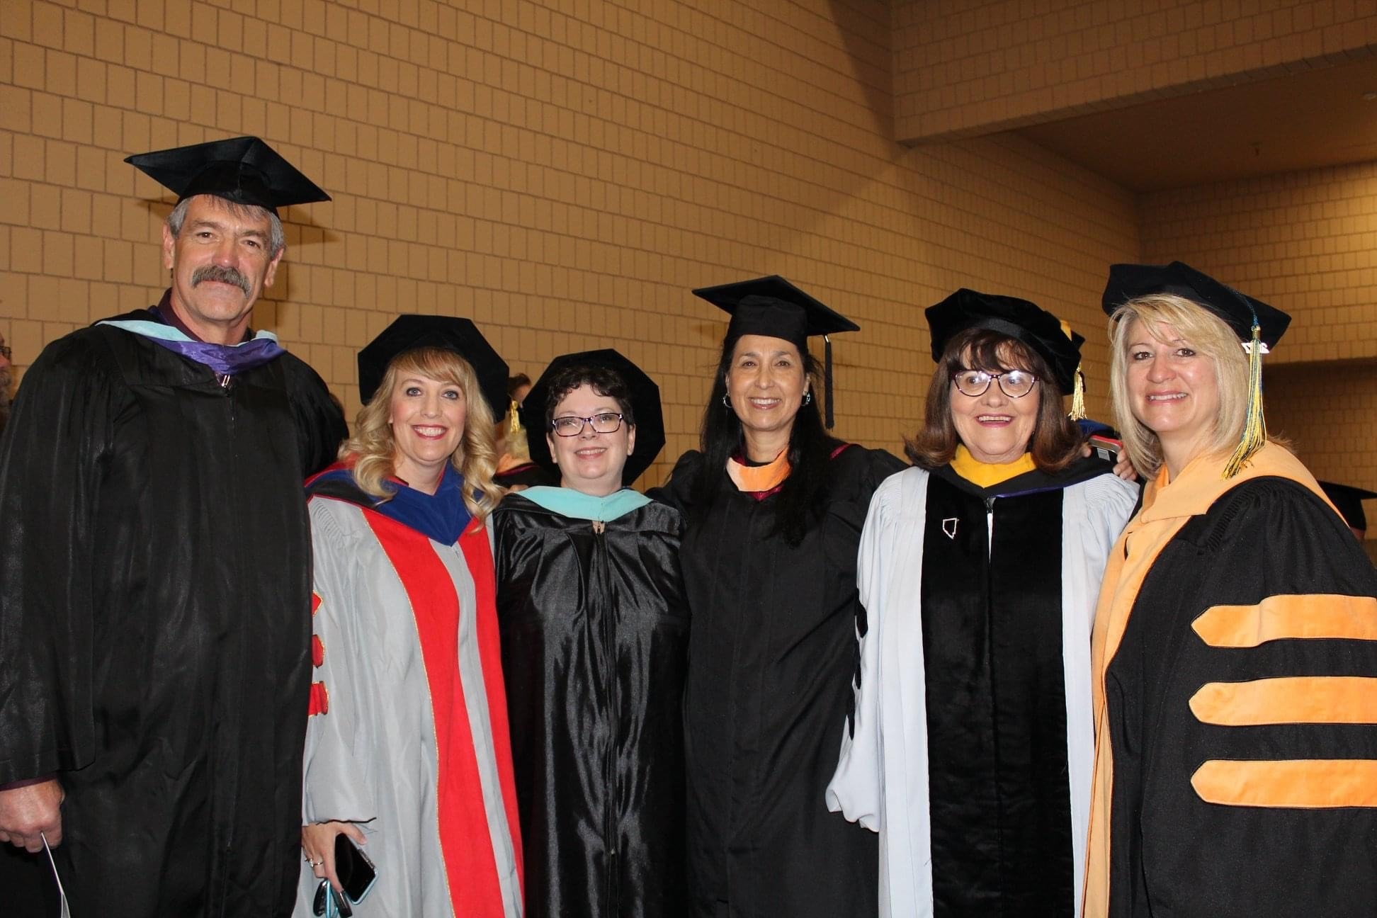
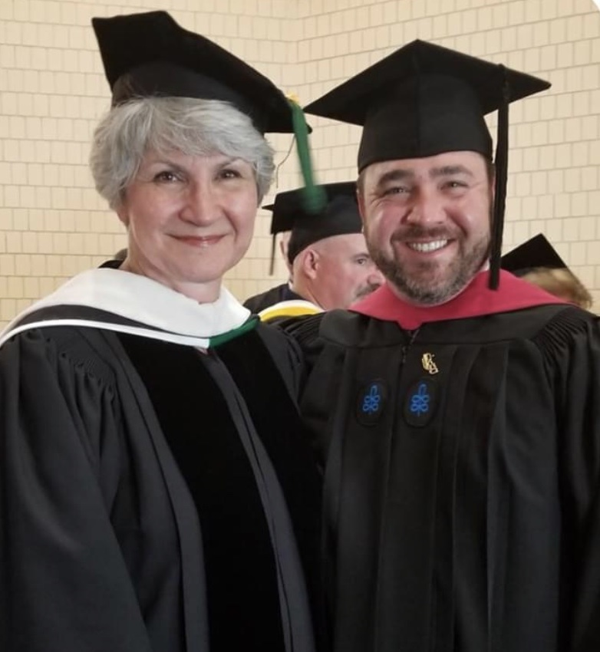
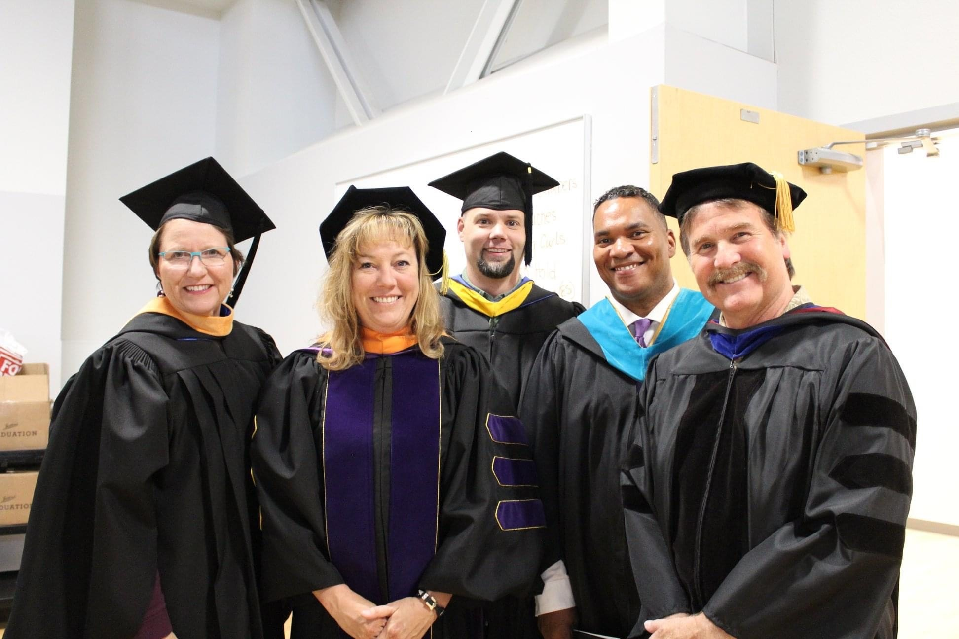
Commendation from Northwest Commission on Colleges and Universities during GBC’s September 2020 accreditation visit
“It’s an atmosphere of caring and collegiality. It is evident that interactions between the students and both faculty and staff are very positive. Students cite time and again all the assistance they receive from both faculty and staff when issues or questions arise. Administrators, faculty, staff, and students alike exhibit a deep sense of pride for this institution, its people, and its mission.”

Slide 3
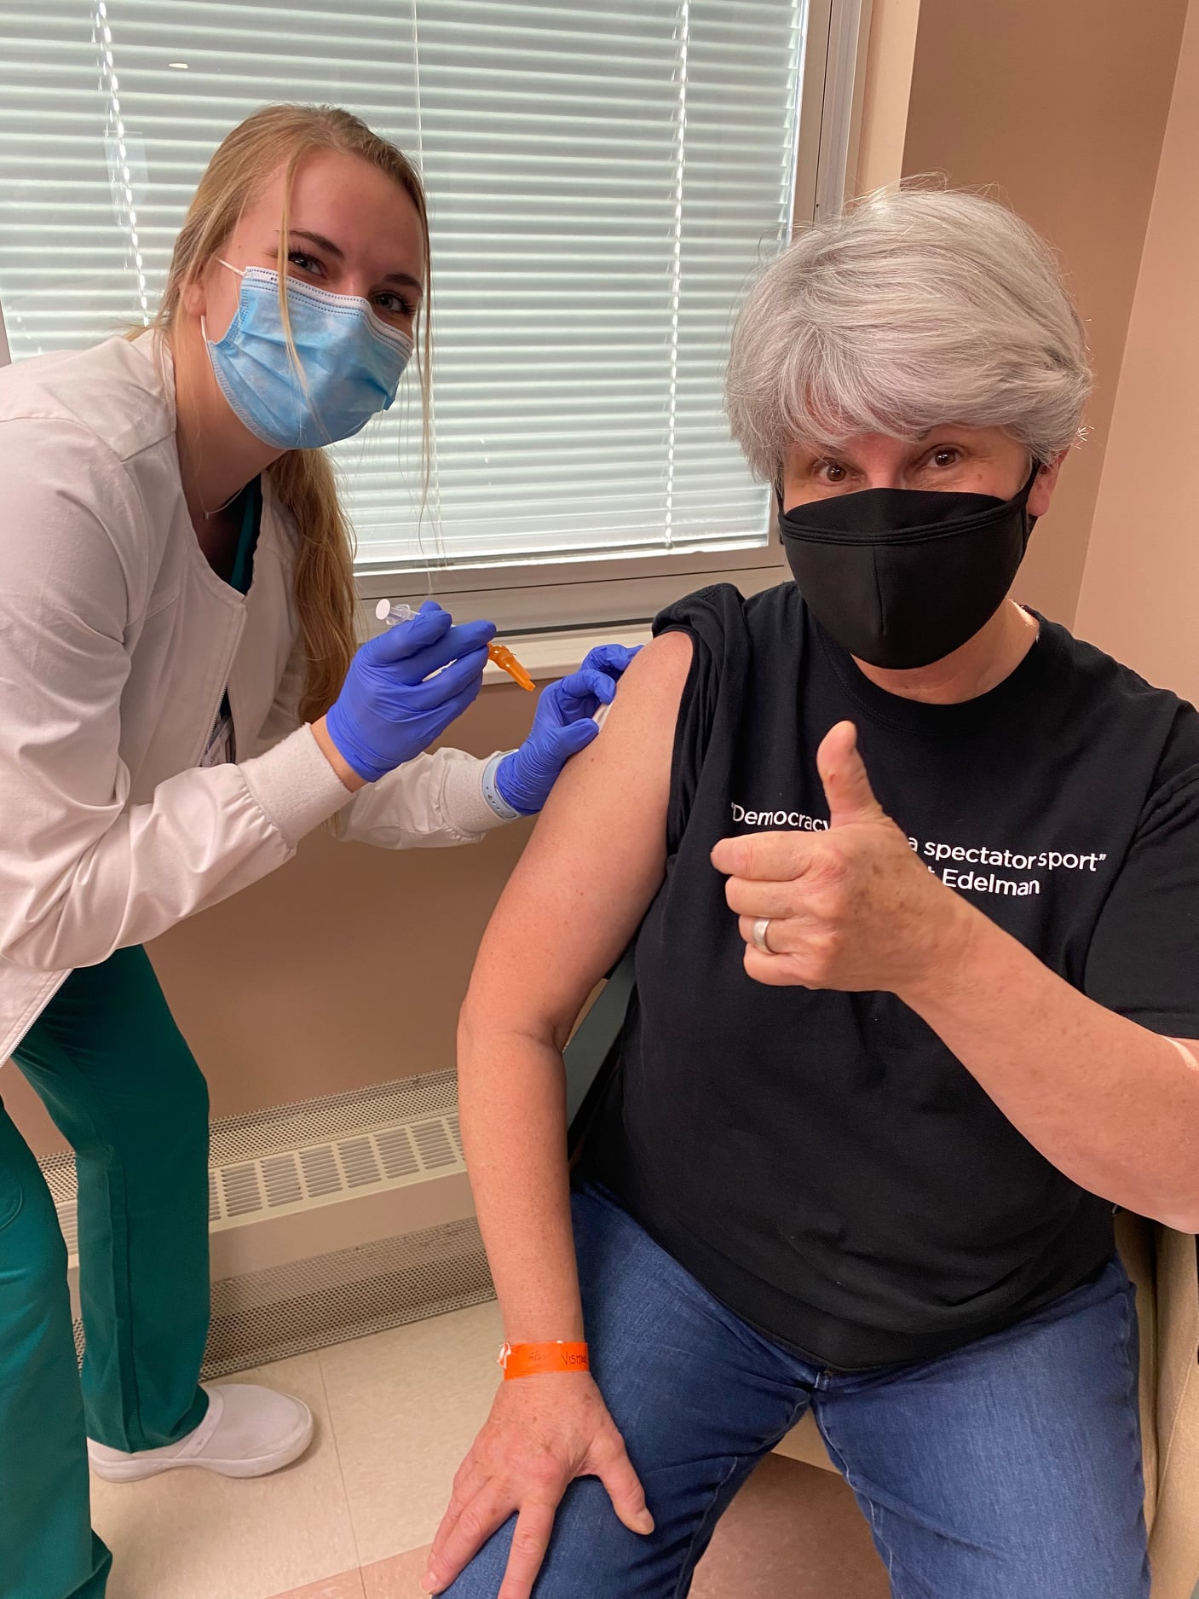
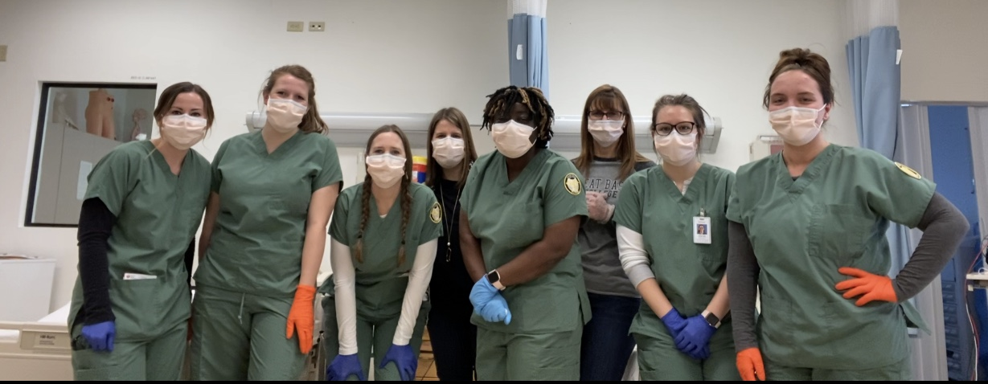
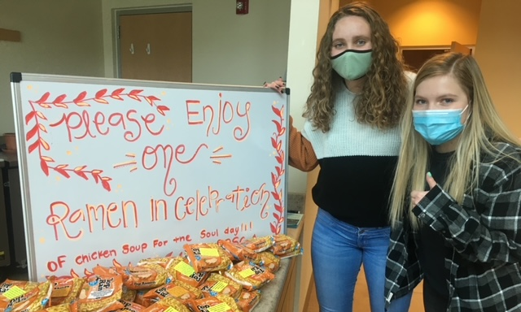
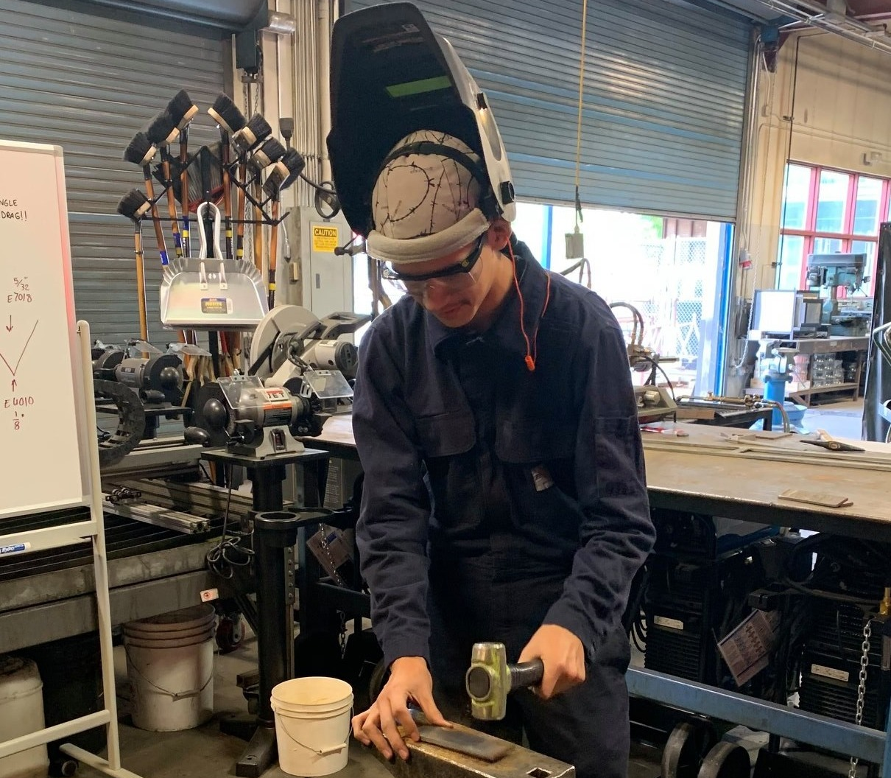
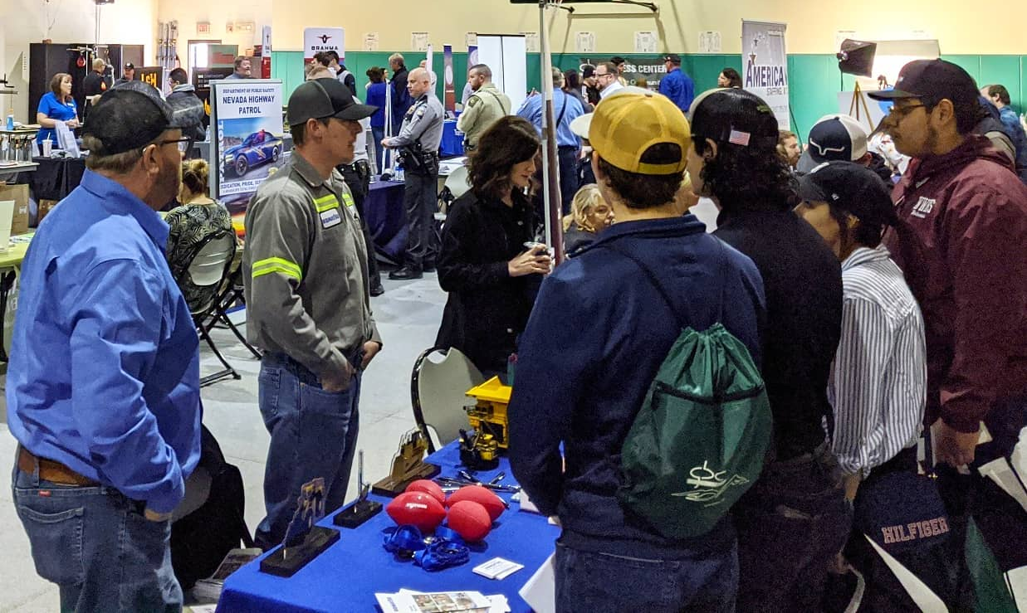

Slide 5
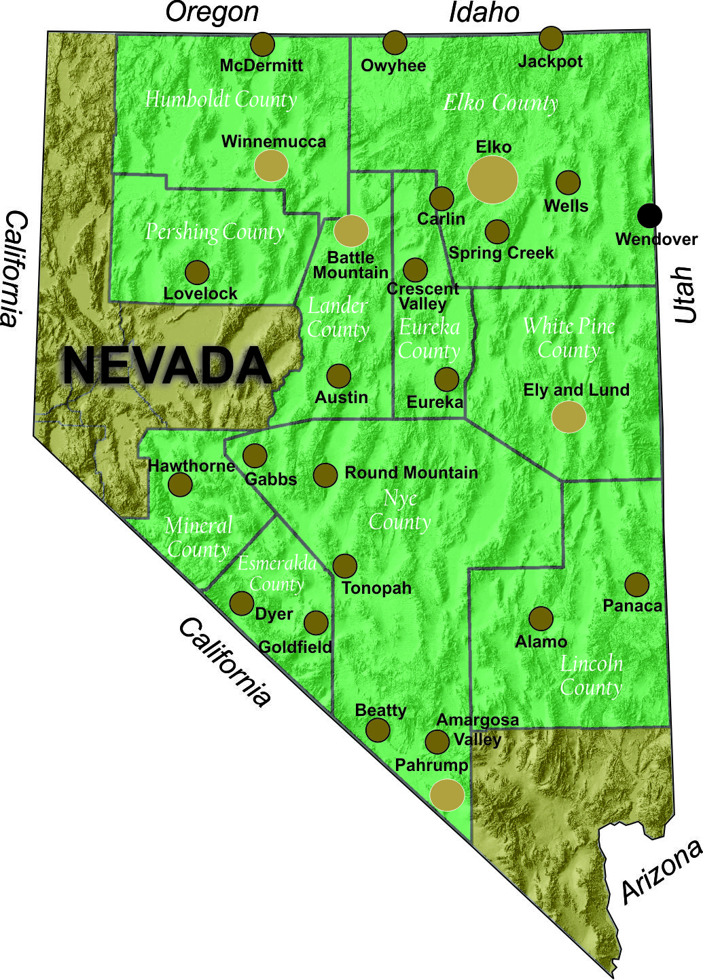
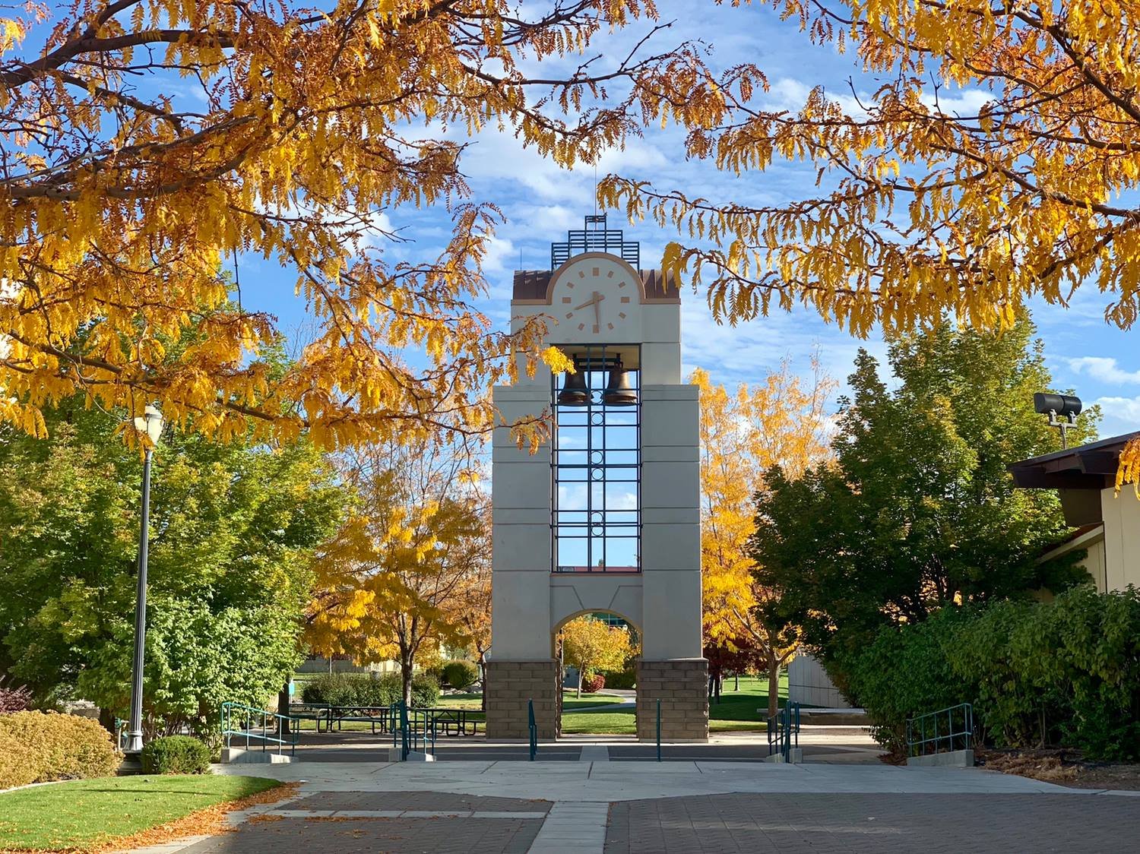
Over 86,000 square miles
2 Time Zones
1 Campus, 4 Centers
Multiple Satellite Locations

Slide 6
Headcount

Slide 7
Fall 2020
Average GBC Student age 25.2
Full-Time

Slide 8
GBC Fall Headcount Trends by Race/Ethnicity

Slide 10
GBC Fall Enrollment Trends by Gender
Source: IPEDS Fall Enrollment Report

Slide 11
GBC Graduation Rate
Great Basin College Graduation Rate | 2016 | 2017 | 2018 | 2019 | 2020
All % | 24.1% | 27.8% | 35.7% | 42.3% | 43.3%
Starting Cohort # | 212 | 216 | 224 | 201 | 263
Graduation # | 51 | 60 | 80 | 85 | 114
*** Includes Full-Time and Part-Time Degree Seeking Bachelor, Associate and Certificate Seeking Students
Source: IPED Completion Rates Fall 20 Data-preliminary

Slide 12
2019 Reported Year Peer Institution Graduation Rates
Graduation Rate
Source: IPED Data Feedback Reports

Slide 13
Graduation Rate by Race/Ethnicity Year: 2020
(First-Time/Full-Time degree seeking students)
Year |  | 2020
Ethnic |  | White | Hispanic | Black | Two Ethnicities or More | Unknown | American Indian/ Alaskan Native | Native Hawaiian/Pacific Islander | Asian | Non-Resident Alien | Total
Grad Rate |  | 46% | 46% | 50% | 38% | 31% | 15% | 100% | 0% | 0%
Starting Cohort # |  | 168 | 54 | 2 | 8 | 13 | 13 | 2 | 2 | 1 | 263
Graduation # |  | 77 | 25 | 1 | 3 | 4 | 2 | 2 | 0 | 0 | 114
Source: IPEDS Graduation Rates Data Report

Slide 14
Degrees and Certificates

Slide 17
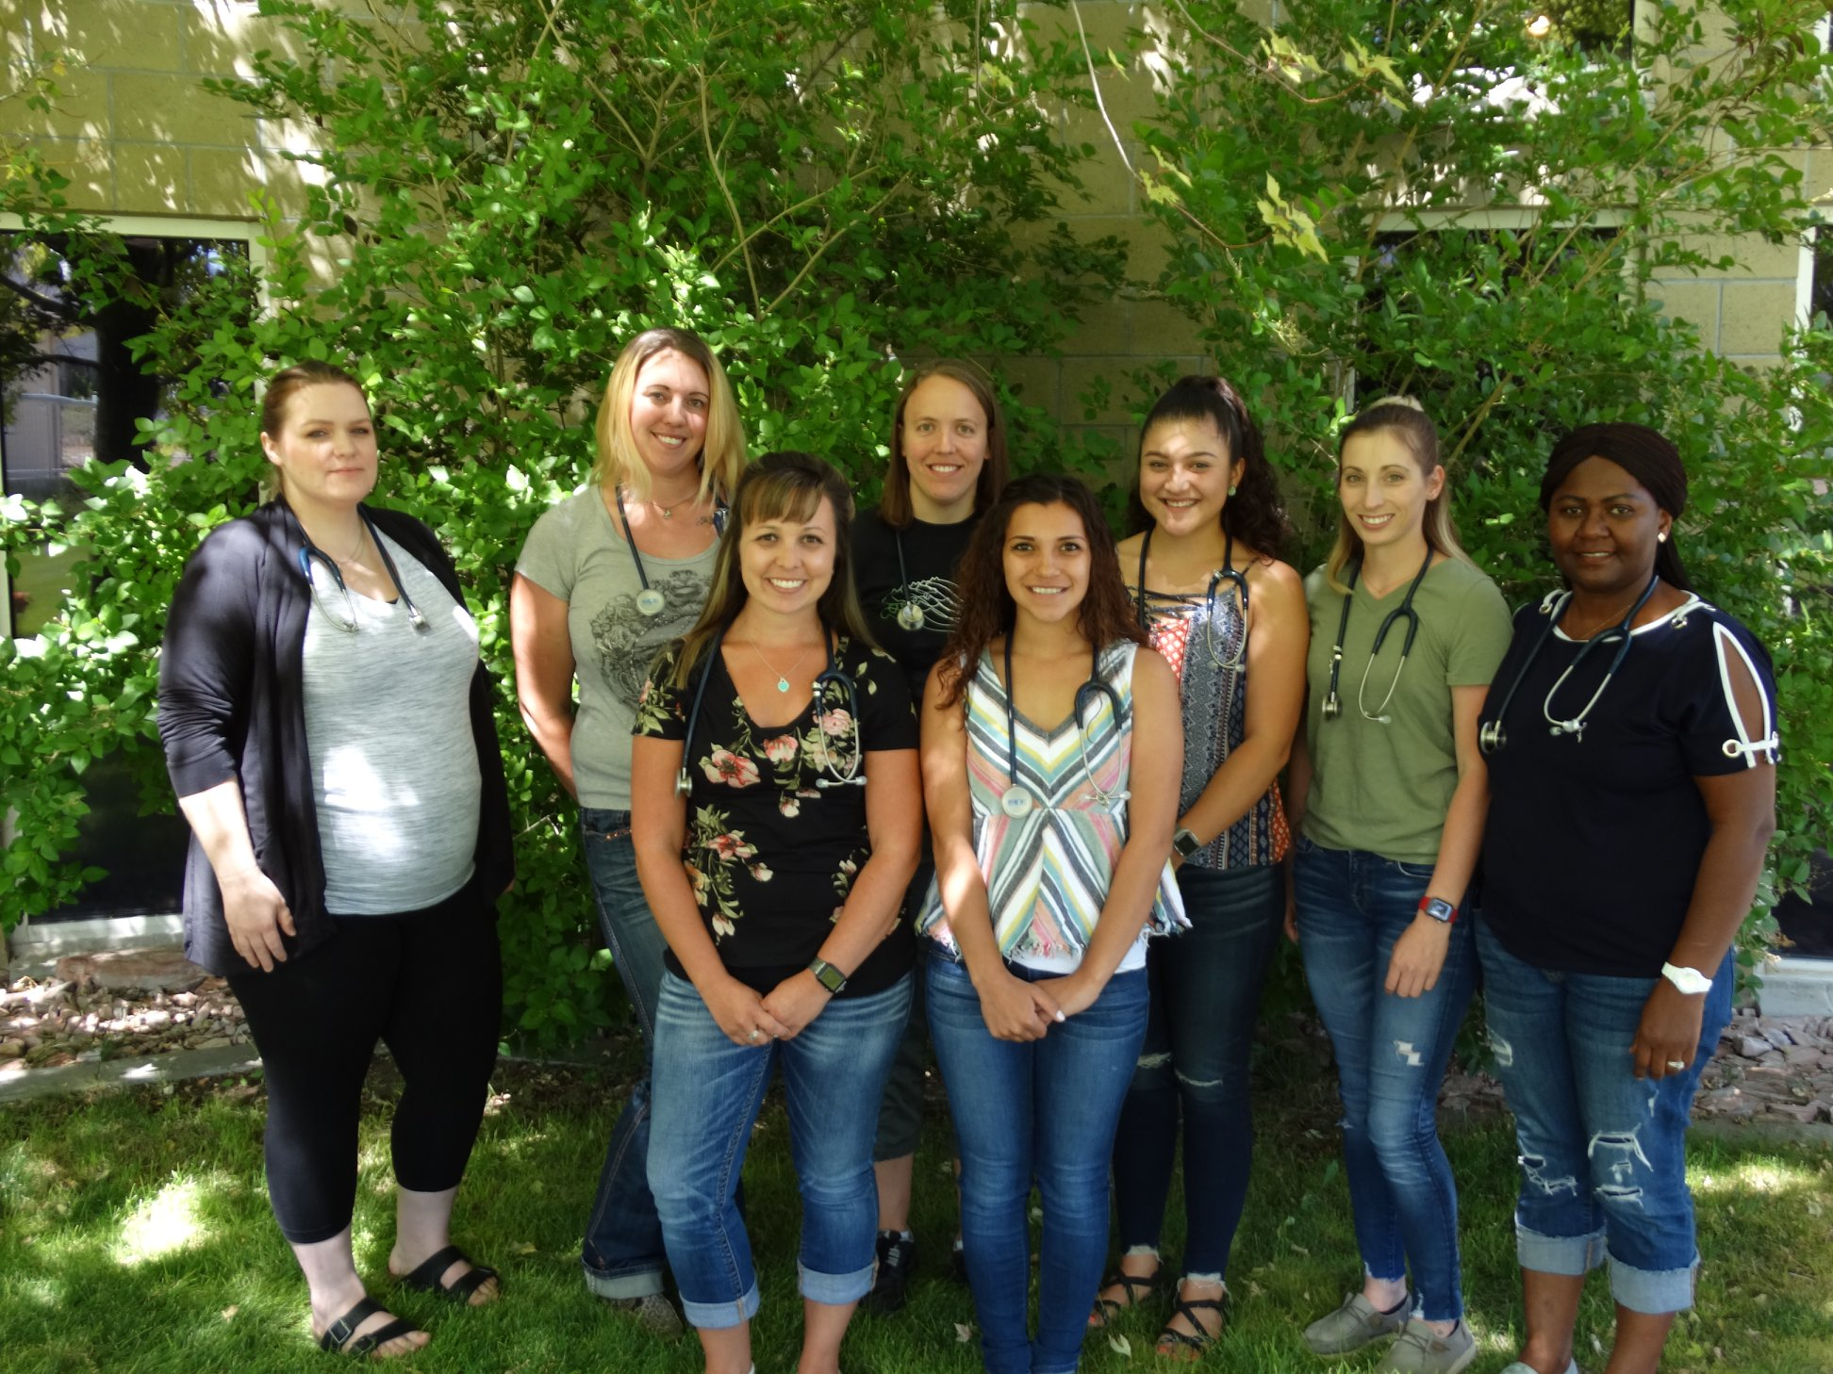
Great Basin College
Percent of Students by Race/Ethnicity Receiving Degrees and Certificates
Source: IPEDS Completions 2020-21

Slide 18
Great Basin College
Fall to Spring Retention First-Time Full-Time Degree Seeking Students

Slide 19
Great Basin College
Fall to Fall Retention First-Time Full-Time Degree Seeking Students

Slide 21
* Accreditation commendation on distance education

Slide 22
Commendation from Northwest Commission on Colleges and Universities during GBC’s September 2020 accreditation visit
"Robust information technology systems that facilitate realistic distance learning applications, that are universally praised by users, and that served as a resource that promoted rapid adaptation for students needing to continue their coursework during the 2020 pandemic. In alignment with information technology, the small distance learning team manages to provide thorough and comprehensive support for high-quality remote instruction in both synchronous and asynchronous modalities."

Slide 24
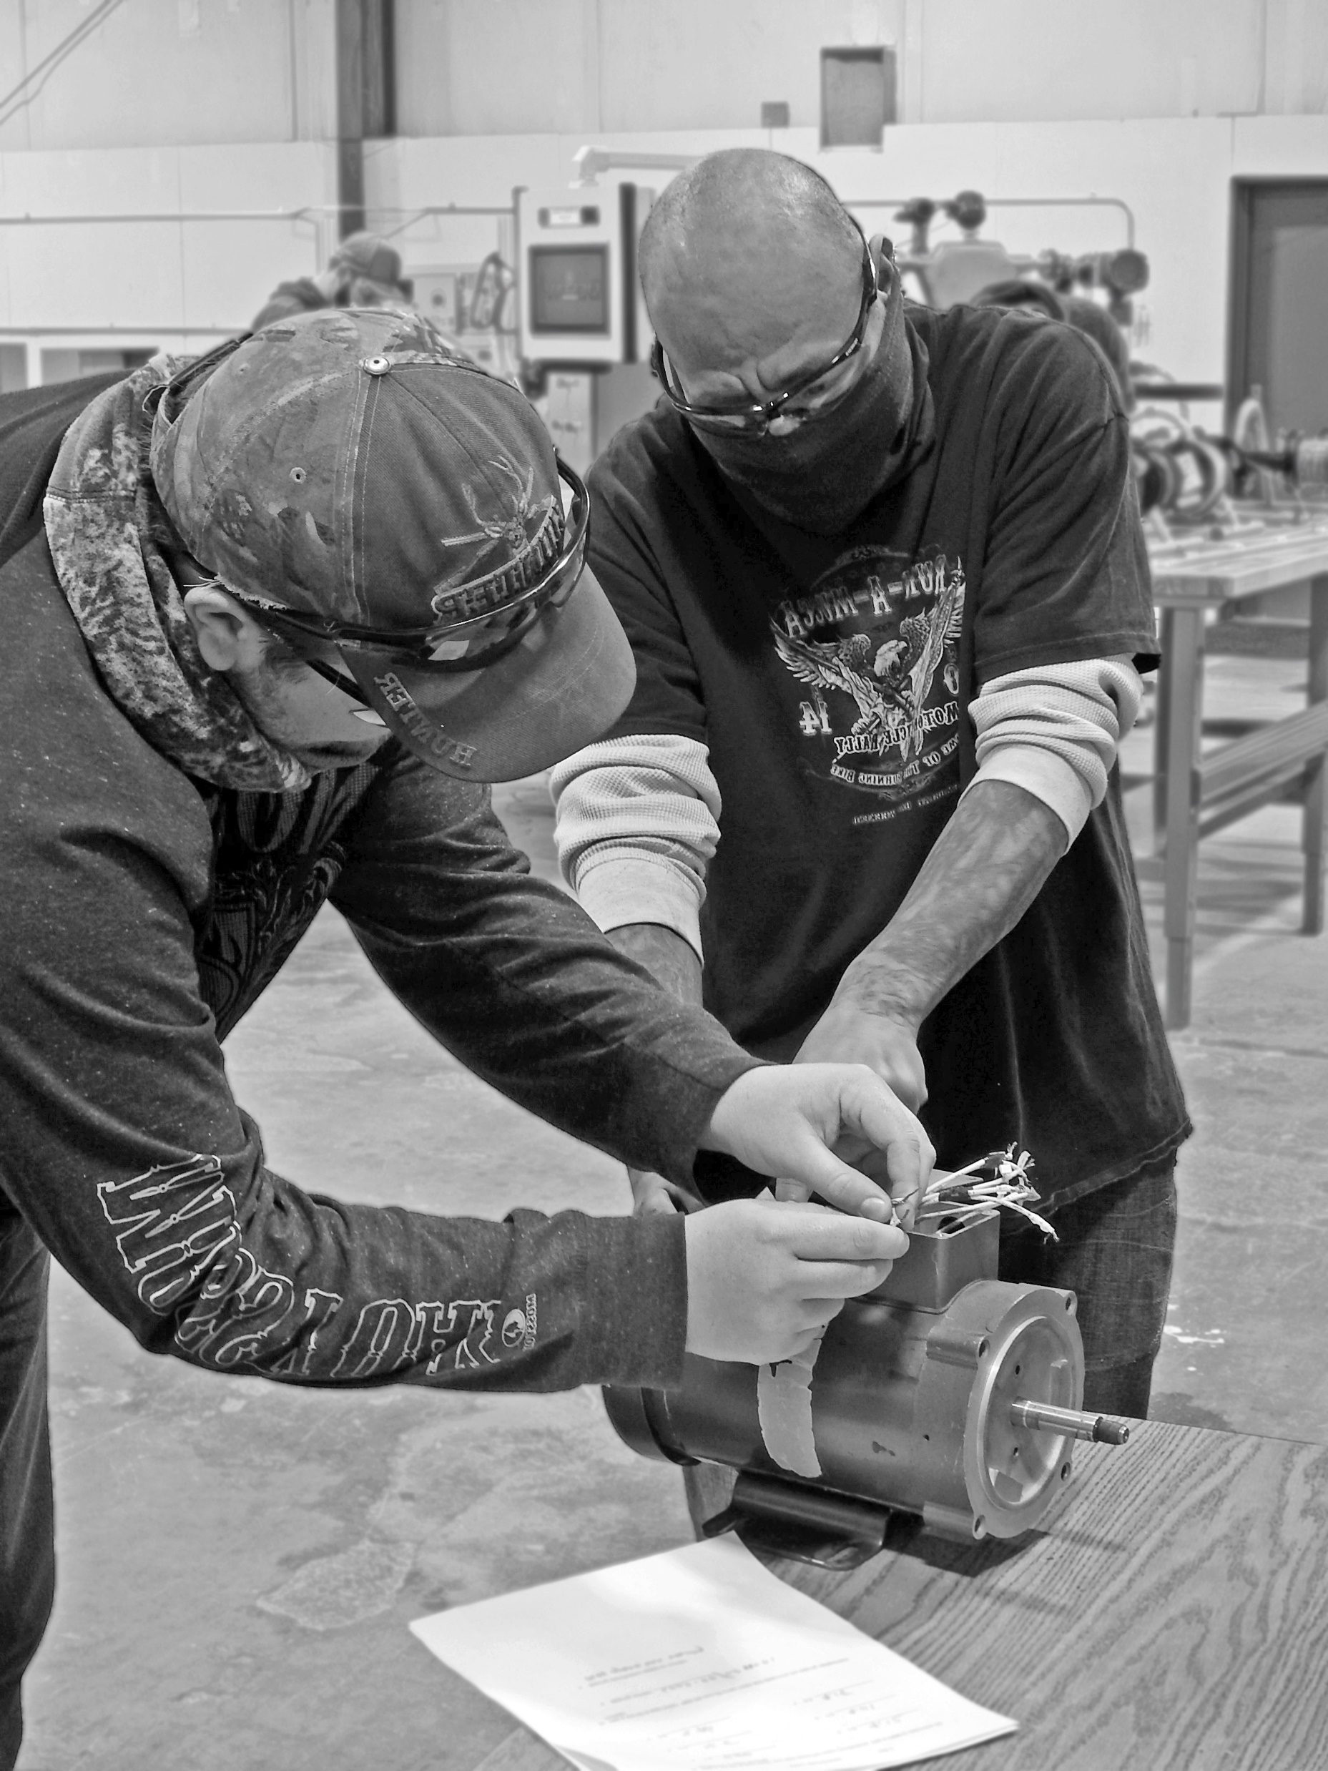
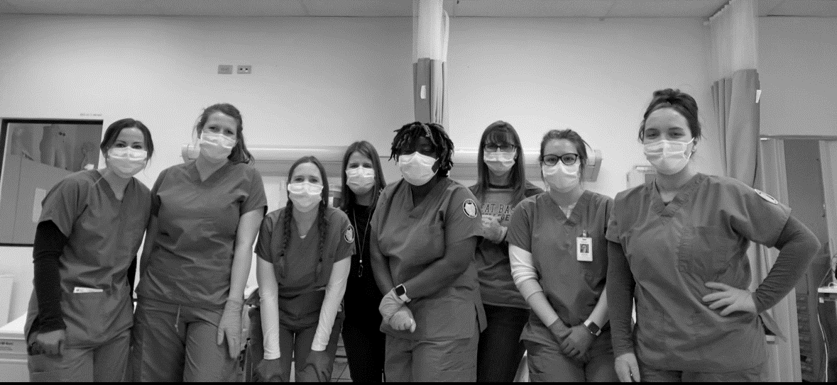

Slide 25
Zachary Stamp – Online Student Government Senator Pursing a Bachelors of Arts – Social Work

Slide 26
Mandatory orientation – Fall 2021 implementation
Mandatory advisement – Spring 2020
Co-Requisite pilot implementation - Fall 2020
Implement curricular review recommendations, i.e.
create additional cohort models
Develop and implement college wide cultural
competency
Broaden collaboration with UNR and other NSHE
institutions

Slide 27
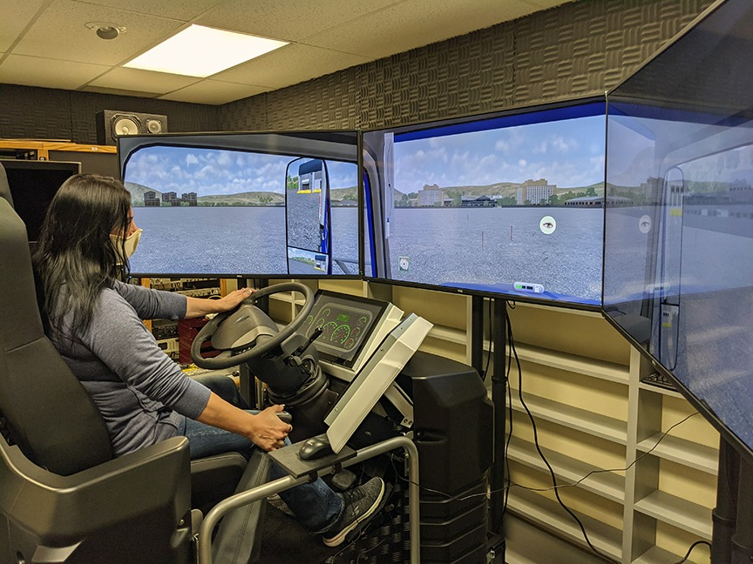

Slide 30
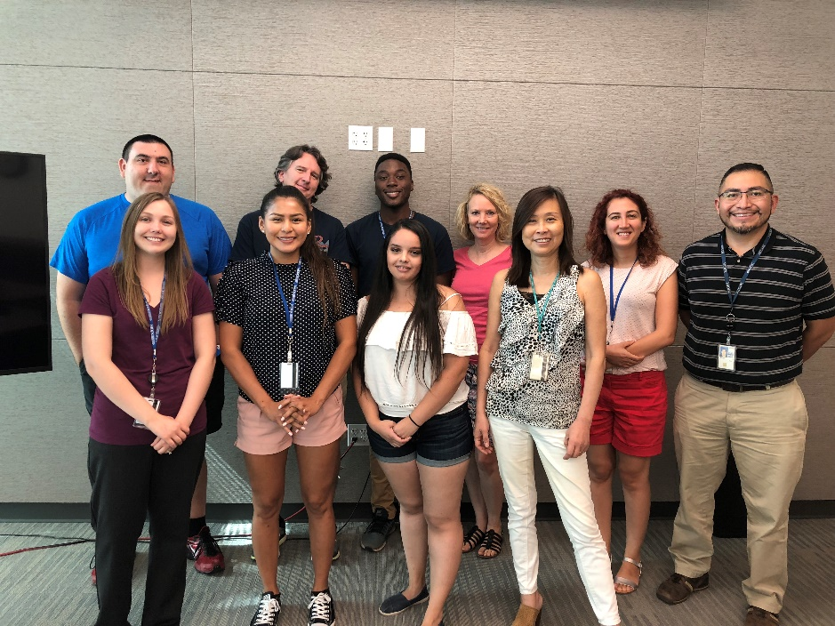
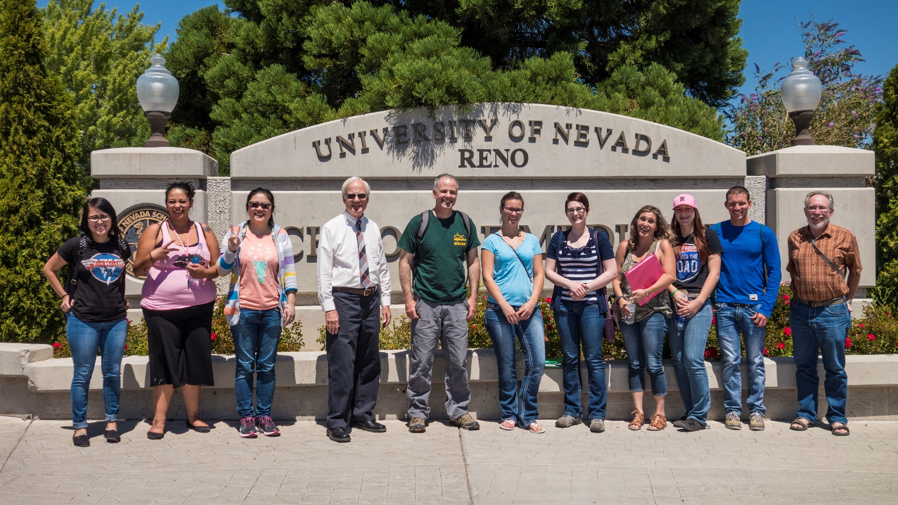
Nevada INBRE IDeA Network of Biomedical Research Excellence

Slide 31
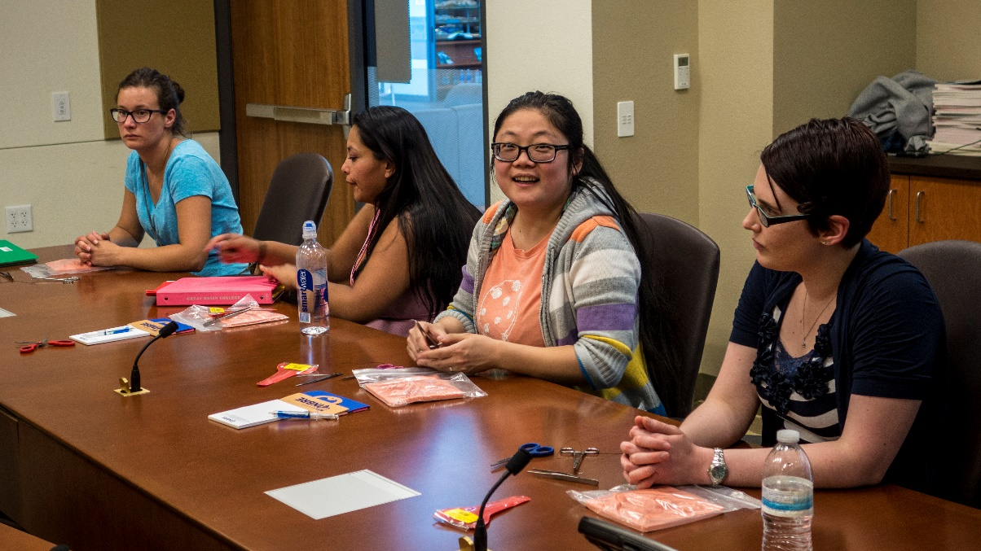
Nevada INBRE IDeA Network of Biomedical Research Excellence
Ten-year partnership
GBC student and GBC faculty research projects at UNR, UNLV, NSC, and GBC Elko/Pahrump campuses
Pre-medical training and advising for GBC students
Extensive lab prep room renovation
Career advising and support of GBC students enrolled in the sciences
Three GBC students have entered and completed pharmacy school
(out of state)
Funding provided a nuclear magnetic resonance spectrometer for organic chemistry

Slide 34
